Slide 1
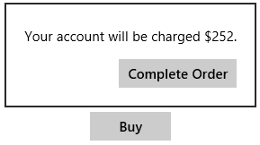
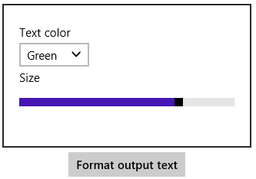
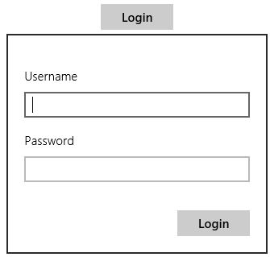
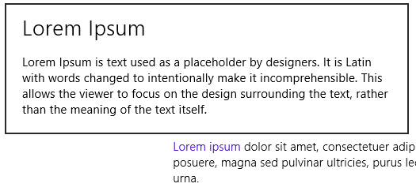
Scenario 1: confirmation flyout
Scenario 3: adjusting settings
Scenario 2: gathering information
Scenario 4: flyout with title

Slide 2
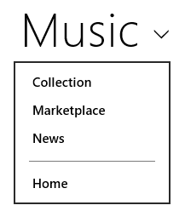
Tap anywhere in header

Slide 3
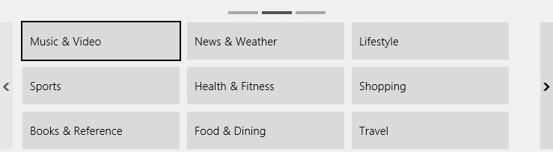
win-navbarcontainer (whole container)
win-navbarcontainer-pageindicator-box
win-navbarcontainer-pageindicator-current
win-navbarcontainer-pageindicator
win-navbarcontainer-viewport win-navbarcontainer-surface
win-navbarcontainer-navarrow
win-navbarcontainer-navleft
win-navbarcontainer-navright
Also uses :hover pseudo-class
Also uses :hover pseudo-class

